Slide 1

Hospital Database Management
Presented by : Yogesh Landge
Role : Data Analyst

Slide 2
About me
Background: B.Tech (Computer Science and Engg)
Why Data Analytics: Becoz I enjoy converting raw data into meaningful insights. SQL and analytics help me understand real-world business problems and make data-driven decisions.
Work Experience: Fresher
LinkedIn: https://www.linkedin.com/in/yogesh-landge-09a175205
GitHub: https://github.com/Yogesh2002-L

Slide 3
Agenda
Objective of the Project
ER Diagram and schema explanation
Key analysis questions (use cases)
SQL query results with screenshots or summaries
Final business insights and recommendations
Conclusion (Key finding overall)
Q&A Slide

Slide 4
Project Storyline (Real-World Context / Scenario)
Storyline (Why & Real-World Context)Hospitals handle thousands of patients, doctors, nurses, rooms, procedures, and medications every day. Managing these activities manually leads to data duplication, errors, and delays in decision-making. This project simulates a real hospital environment where a centralized database is required to track patient journeys from appointment to treatment and discharge efficiently.
Data Source (Where data came from)The dataset is a structured sample hospital database commonly used in real-world healthcare system design and academic case studies. It closely represents actual hospital operations such as appointments, admissions, procedures, prescriptions, staff allocation, and room management.

Slide 5
Problem Statement & Objectives
Problem Statement :-
Hospitals face challenges in managing patient records, staff scheduling, room availability, and treatment data when information is stored manually or across multiple systems. This results in inefficiency, lack of transparency, and poor decision-making.
Project Objectives
To design a normalized relational database for hospital operations.
To efficiently store and manage patient, doctor, nurse, room, and treatment data.
To reduce manual record-keeping and improve accuracy and efficiency in hospital management.
Hospitals provide essential medical services, but managing daily activities manually is difficult and error-prone. A database system is required to maintain accurate records and support smooth hospital operations.

Slide 6
Why a Relational Database Is Needed
Hospital data is highly structured and interrelated.
Entities like patients, physicians, appointments, and procedures depend on each other
Relational databases:
- Reduce data redundancy
      - Maintain data consistency
      - Enforce relationships using keys
      - Support complex analytical queries
      SQL enables hospitals to quickly answer questions like:
      - Which doctors treated which patients?
      - Which rooms are available?
      - Which physicians are certified for procedures?

Slide 7
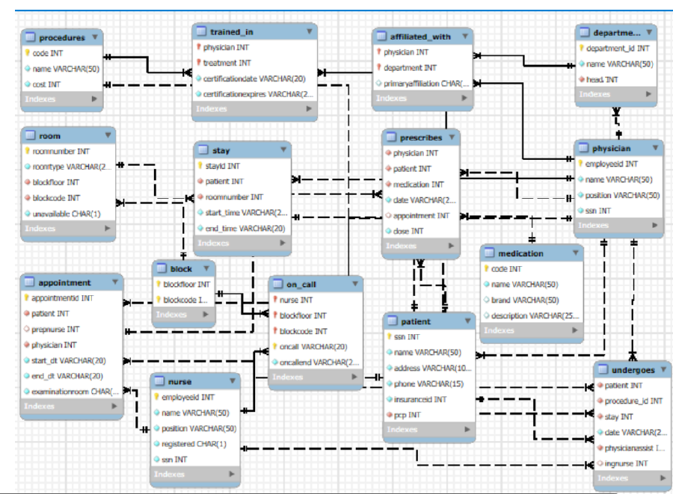
ER Diagram and schema explanation

Slide 8
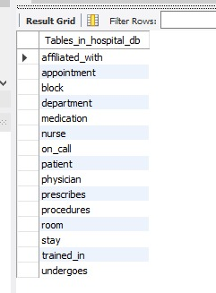
Database Table overview

Slide 9
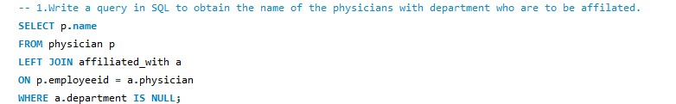
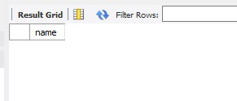
SQL query results with screenshots or summaries
1. Write a query in SQL to obtain the name of the physicians with department who are yet to be affiliated
Insight :-
This query identifies physicians who are not yet affiliated with any department, highlighting gaps in departmental assignment.
Output:-

Slide 10
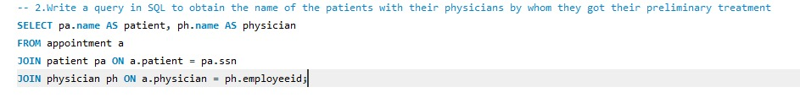
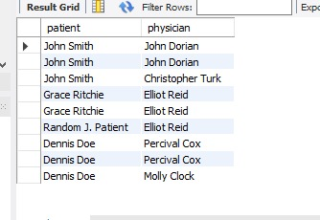
2. Write a query in SQL to obtain the name of the patients with their physicians by whom they got their preliminary treatment
Output:-
Insight :-
It shows each patient along with the doctor who provided their initial treatment.

Slide 11
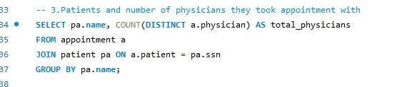
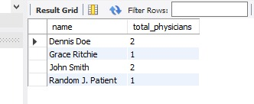
3. Write a query in SQL to find the name of the patients and the number of physicians they have taken appointment
Insight :-
It shows each patient and how many different doctors they have taken appointments with.
Output:-

Slide 12
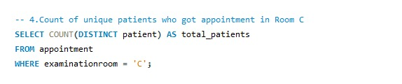
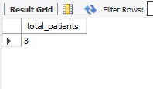
4. Write a query in SQL to count number of unique patients who got an appointment for examination room C
Insight :-
There are 3 unique patients who had appointments in Room C.
Output:-

Slide 13
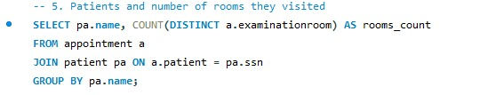
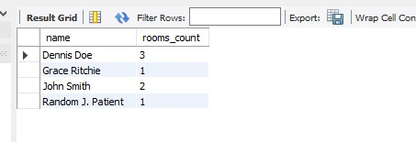
5. Write a query in SQL to find the name of the patients and the number of the room where they have to go for their treatment
Insight :-
It shows how many different examination rooms each patient has visited.
Output:-

Slide 14

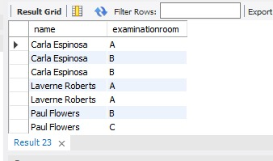
6. Write a query in SQL to find the name of the nurses and the room scheduled, where they will assist the physicians.
Insight :-
It shows which nurses assisted physicians and the examination rooms where they were scheduled.
Output:-

Slide 15
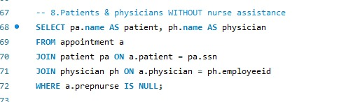
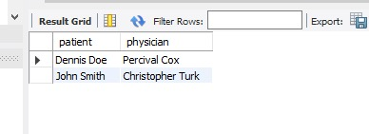
7. Write a query in SQL to find the name of patients and their physicians who does not require any assistance of a nurse
Insight :-
It shows patients and doctors where no nurse assistance was involved during the appointment.
Output:-

Slide 16
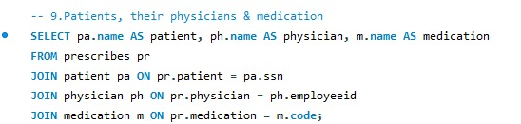
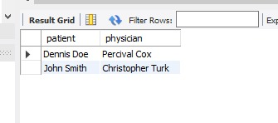
8. Write a query in SQL to find the name of the patients, their treating physicians and medication
Output:-
Insight :-
It shows which doctor prescribed medication to each patient.

Slide 17
Business Insights & Conclusions
Key Business Insights
Identified patient-doctor relationships and treatment history.
Tracked room utilization and availability across blocks and floors.
Analyzed nurse involvement in procedures and appointments.
Monitored physician certifications and compliance.
Evaluated appointment patterns and patient flow.

Slide 18
Conclusion
A centralized hospital database significantly improves operational efficiency.
SQL-based analysis supports data-driven healthcare decisions.
The system ensures better resource utilization and patient care quality.
This project demonstrates how databases solve real-world healthcare problems.

Slide 19

THANK YOU

